Slide 1

HETEROSCEDASTICITY
Presented by
Reshma shah
Msc previous

Slide 2
INTRODUCTION
NATURE OF HETEROSCEDASTICITY
CONSEQUENCES
OLS ( Ordinary least square ) and GLS (Generalised least square)
DIFFERENCE BETWEEN OLS AND GLS
DETECTION OF HETEROSCEDASTICITY
REFERENCE

Slide 3
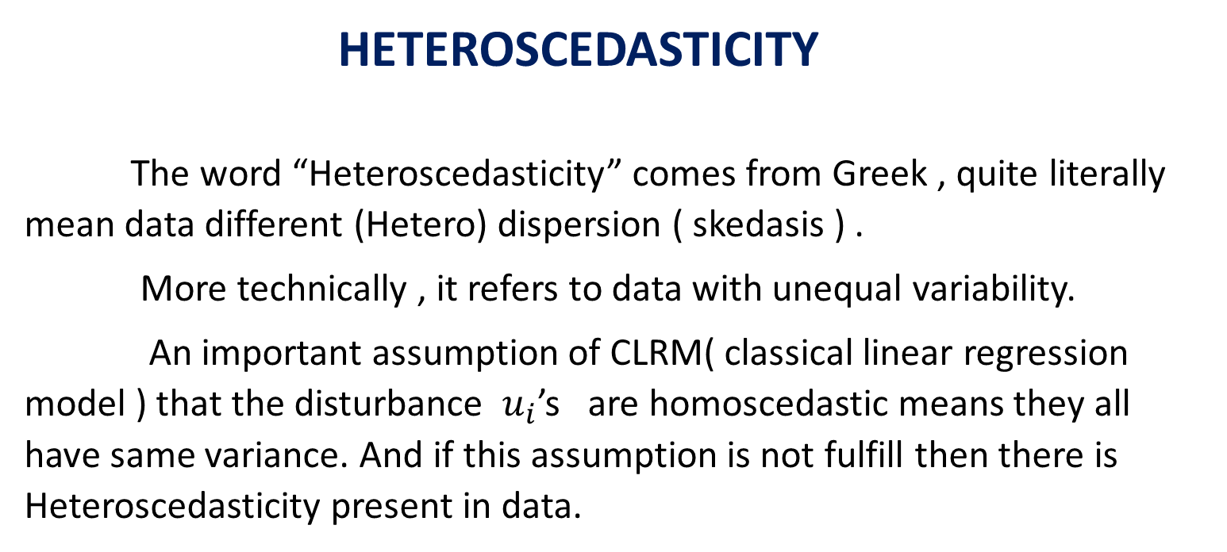
HETEROSCEDASTICITY
The word “Heteroscedasticity” comes from Greek , quite literally mean data different (Hetero) dispersion ( skedasis ) .
More technically , it refers to data with unequal variability.
An important assumption of CLRM( classical linear regression model ) that the disturbance $u_{i}$’s are homoscedastic means they all have same variance. And if this assumption is not fulfill then there is Heteroscedasticity present in data.

Slide 4
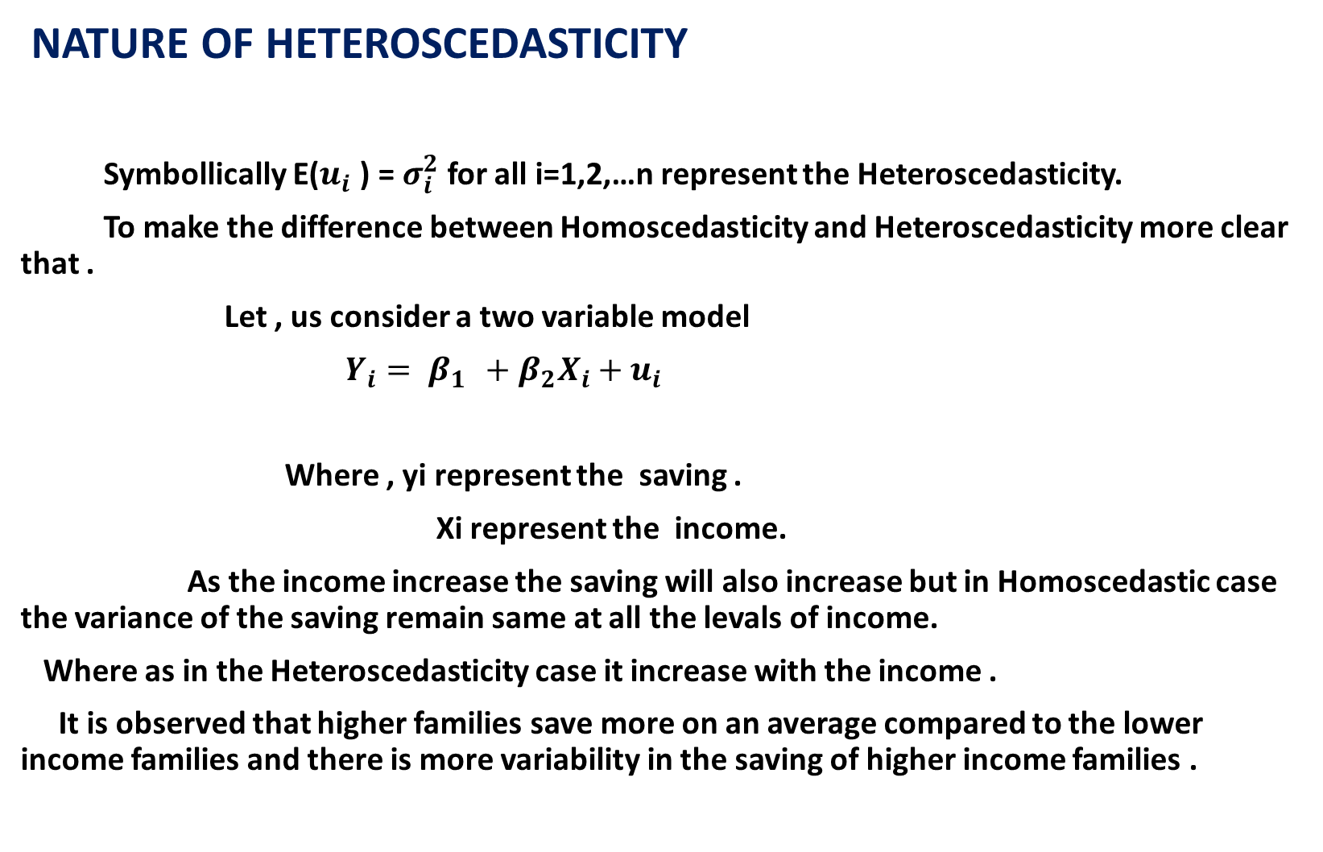
NATURE OF HETEROSCEDASTICITY
Symbollically E($u_{i}$ ) = $σ_{i}^{2}$ for all i=1,2,…n represent the Heteroscedasticity.
To make the difference between Homoscedasticity and Heteroscedasticity more clear that .
Let , us consider a two variable model
$Y_{i}= β_{1 }+β_{2}X_{i}+u_{i}$
Where , yi represent the saving .
Xi represent the income.
As the income increase the saving will also increase but in Homoscedastic case the variance of the saving remain same at all the levals of income.
Where as in the Heteroscedasticity case it increase with the income .
It is observed that higher families save more on an average compared to the lower income families and there is more variability in the saving of higher income families .

Slide 5
Why the variance is not constant there are several reason listed below.
1] following the error learning models , as people learn from there errors of performance , it is expected that these errors will become small over a period of time and this case
variance expected to decrease.
2] As the income grows people have more discretionary income and hence , more scope for
choice about the disposition of income . hence , variance is likely to increase with income
because people have more choices about their saving behaviour .
3] As the data collecting techniques improves , variance is likely to decrease. i.e, saving is
Decrease.

Slide 6
4] Heteroscedasticity can also arise as the result of the prenses of the outliears.
-
5] A major source of Heteroscedasticity is the skewed nature of one or more regressior
Included in model .
6] DAVID HENRY points out that the Heteroscedasticity can also arise because of
(i) Incorrect data transformation .
(ii) Incorrect functional form of the models .
The problem of Heteroscedasticity is more comman in “CROSS SECTIONAL DATA “ .
As in the cross sectional data one usually deals with member of population at a given point in time, such as indivisual consumers , families or a geographical location such as city , state or country etc. This is vary in size such such as small , medium , large which will introduce Heteroscedasticity .
In a time series data , there is associated variable tend to be of similar nature and of similar order of because a set of observations on the values that variable takes a different time . for eg., GDP , consumption expenditure, savings , or employment in India , say for the period of 1950-51 to 2009-10.

Slide 7
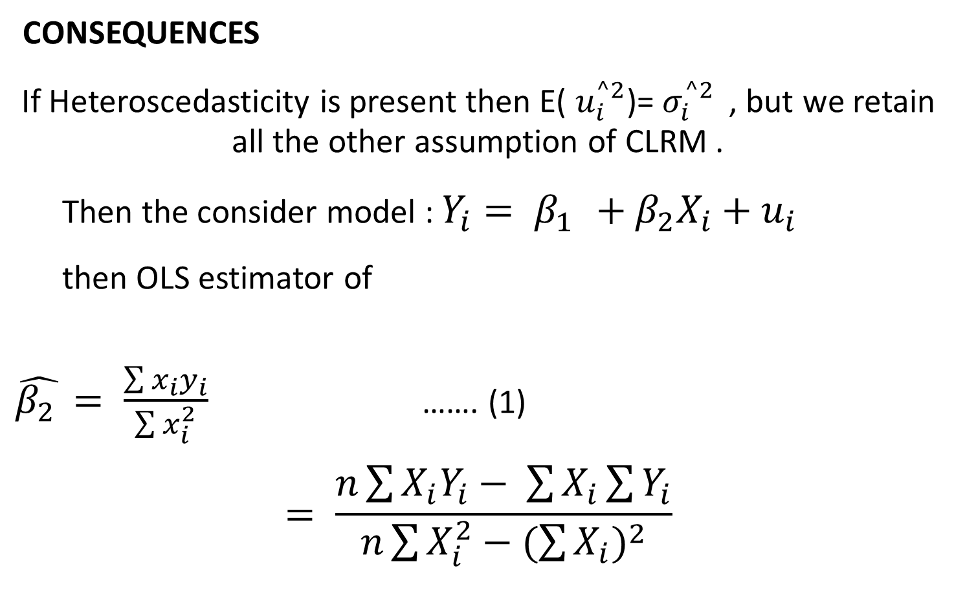
CONSEQUENCES
If Heteroscedasticity is present then E( $u_{i}^{^2}$)= $σ_{i}^{^2 }$ , but we retain all the other assumption of CLRM .
Then the consider model : $Y_{i}= β_{1 }+β_{2}X_{i}+u_{i}$
then OLS estimator of
$\hat{β_{2 }}= \frac{\sum{x_{i}y_{i}}}{\sum{x_{i}^{2}}}$ ……. (1)
$$= \frac{n\sum{X_{i}Y_{i}− \sum{X_{i}\sum{Y_{i}}}}}{n\sum{X_{i}^{2}}−{(\sum{X_{i}})}^{2}}$$

Slide 8
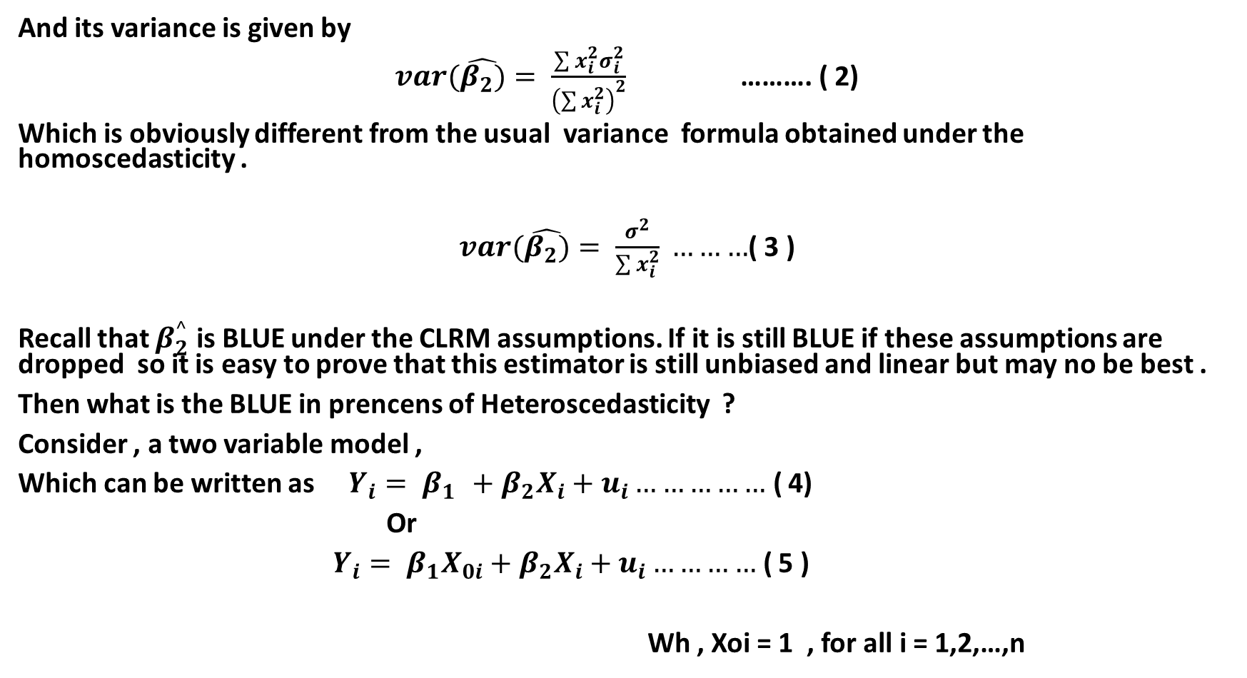
And its variance is given by
$var(\hat{β_{2})}= \frac{\sum{x_{i}^{2}σ_{i}^{2}}}{{\left(\sum{x_{i}^{2}}\right)}^{2}}$ ………. ( 2)
Which is obviously different from the usual variance formula obtained under the homoscedasticity .
$var(\hat{β_{2})}= \frac{σ^{2}}{\sum{x_{i}^{2}}} ………$( 3 )
Recall that $β_{2}^{^}$ is BLUE under the CLRM assumptions. If it is still BLUE if these assumptions are dropped so it is easy to prove that this estimator is still unbiased and linear but may no be best .
Then what is the BLUE in prencens of Heteroscedasticity ?
Consider , a two variable model ,
Which can be written as $Y_{i}= β_{1 }+β_{2}X_{i}+u_{i}……………$ ( 4)
Or
$Y_{i}= β_{1}X_{0i}+β_{2}X_{i}+u_{i}…………$ ( 5 )
Wh , Xoi = 1 , for all i = 1,2,…,n

Slide 9
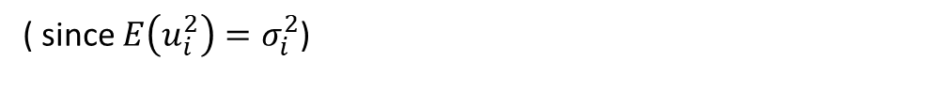
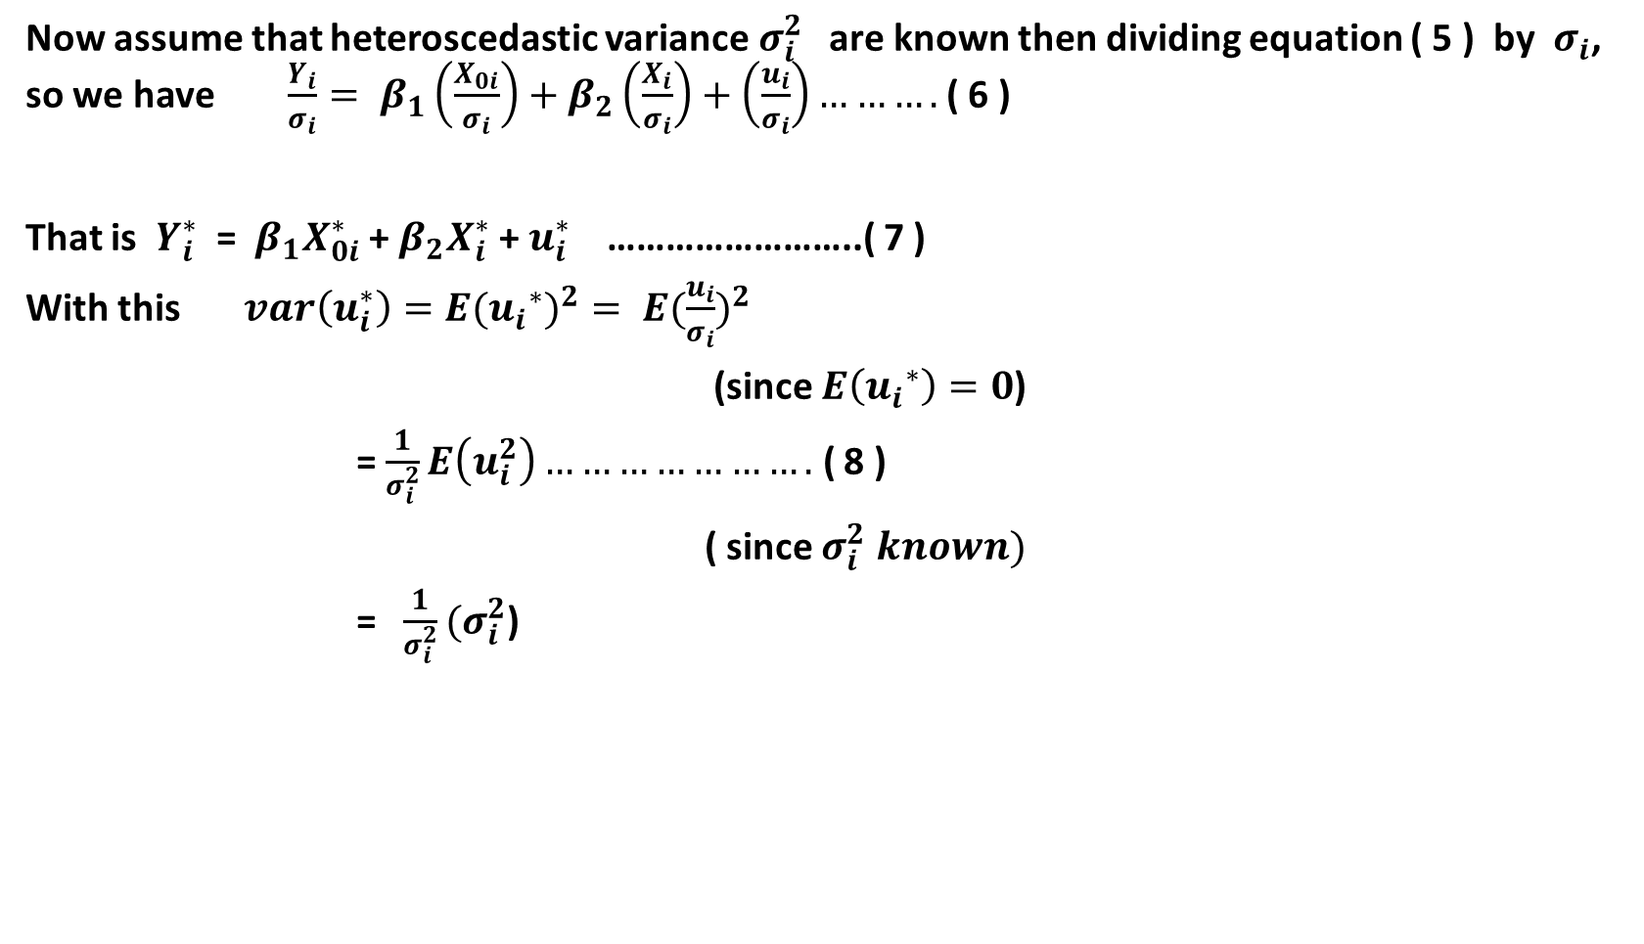
Now assume that heteroscedastic variance$σ_{i}^{2}$ are known then dividing equation ( 5 ) by $σ_{i}$, so we have $\frac{Y_{i}}{σ_{i}}= β_{1}\left(\frac{X_{0i}}{σ_{i}}\right)+β_{2}\left(\frac{X_{i}}{σ_{i}}\right)+\left(\frac{u_{i}}{σ_{i}}\right)……….$ ( 6 )
That is $Y_{i}^{∗}$ = $β_{1}X_{0i}^{∗}$ + $β_{2}X_{i}^{∗}$ + $u_{i}^{∗}$ ……………………..( 7 )
With this $var\left(u_{i}^{∗}\right)={E({u_{i}}^{∗})}^{2}= {E(\frac{u_{i}}{σ_{i}})}^{2}$
(since $E\left({u_{i}}^{∗}\right)=0$)
= $\frac{1}{σ_{i}^{2}}E\left(u_{i}^{2}\right)………………….$ ( 8 )
( since $σ_{i}^{2} known)$
= $\frac{1}{σ_{i}^{2}}(σ_{i}^{2}$)
( since $E\left(u_{i}^{2}\right)=σ_{i}^{2}$)
= 1

Slide 10
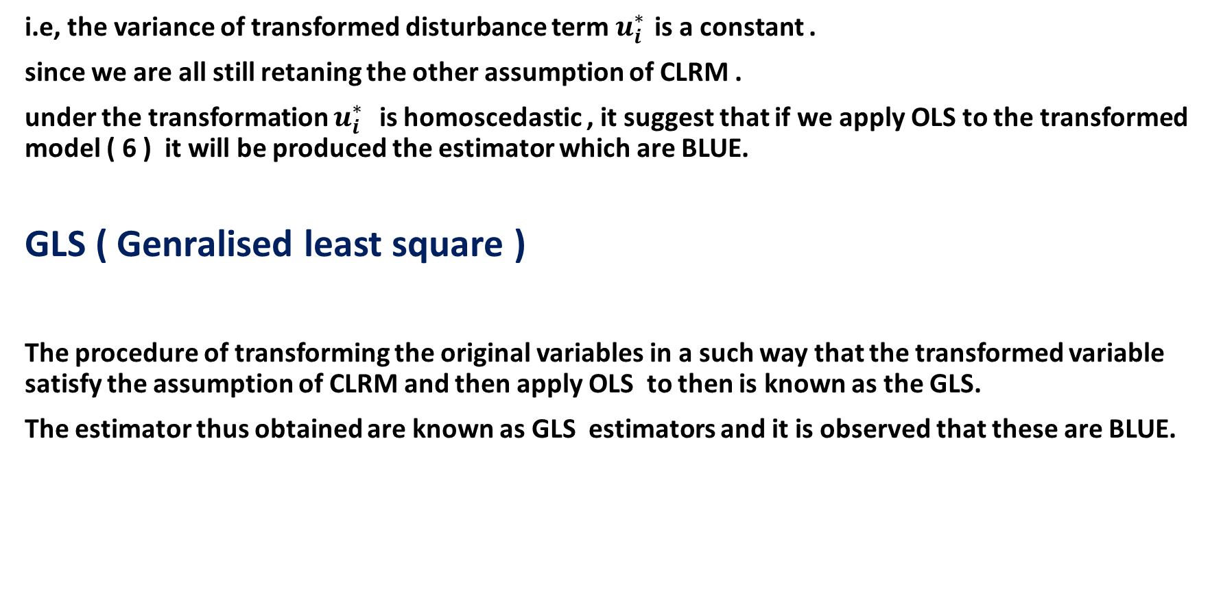
i.e, the variance of transformed disturbance term $u_{i}^{∗ }$is a constant .
since we are all still retaning the other assumption of CLRM .
under the transformation $u_{i}^{∗ }$ is homoscedastic , it suggest that if we apply OLS to the transformed model ( 6 ) it will be produced the estimator which are BLUE.
GLS ( Genralised least square )
The procedure of transforming the original variables in a such way that the transformed variable satisfy the assumption of CLRM and then apply OLS to then is known as the GLS.
The estimator thus obtained are known as GLS estimators and it is observed that these are BLUE.

Slide 11
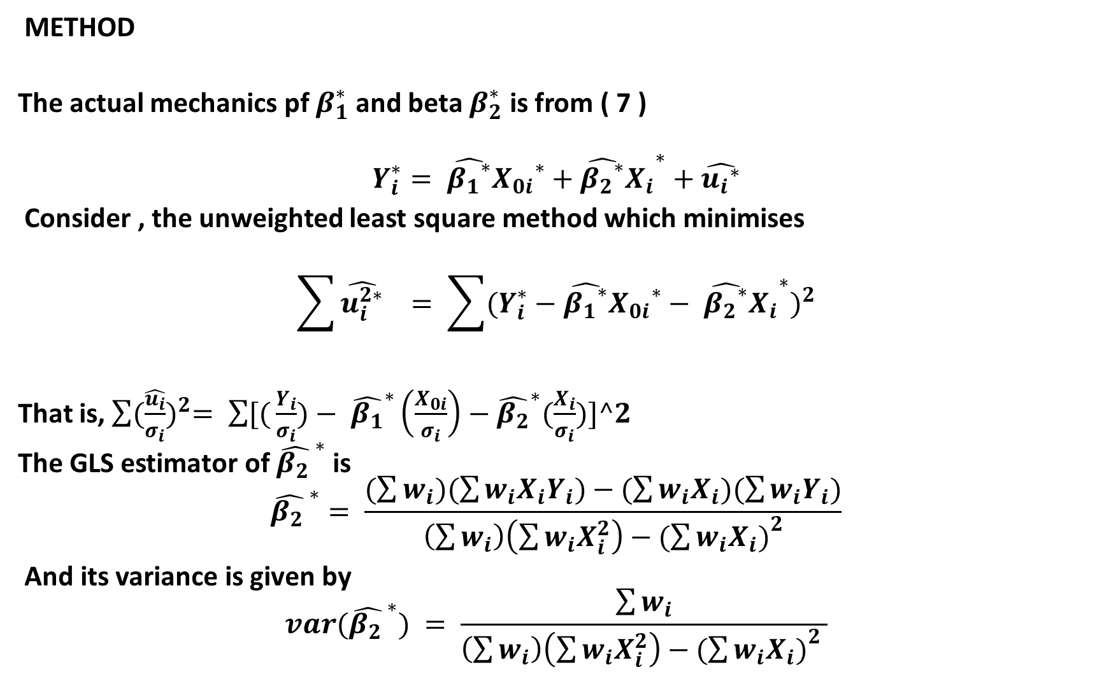
METHOD
The actual mechanics pf $β_{1}^{∗}$ and beta $β_{2}^{∗}$ is from ( 7 )
$$Y_{i}^{∗}= \hat{{β_{1}}^{∗}}{X_{0i}}^{∗}+{{\hat{{β_{2}}^{∗}}X}_{i}}^{∗}+\hat{{u_{i}}^{∗}}$$
Consider , the unweighted least square method which minimises
$$\sum{\hat{u_{i}^{2∗}}} = \sum{({Y_{i}^{∗}−\hat{{β_{1}}^{∗}}{X_{0i}}^{∗}− {{\hat{{β_{2}}^{∗}}X}_{i}}^{∗})}^{2}}$$
That is, $\sum{{(\frac{\hat{u_{i}}}{σ_{i}})}^{2}= \sum{[(}}\frac{Y_{i}}{σ_{i}})− {\hat{β_{1}}}^{∗}\left(\frac{X_{0i}}{σ_{i}}\right)−{\hat{β_{2}}}^{∗}(\frac{X_{i}}{σ_{i}})]^2$
The GLS estimator of ${\hat{β_{2 }}}^{∗}$ is
$${\hat{β_{2 }}}^{∗}= \frac{(\sum{w_{i})(\sum{w_{i}X_{i}Y_{i})−(\sum{w_{i}X_{i})(\sum{w_{i}Y_{i}})}}}}{\left(\sum{w_{i}}\right)\left(\sum{w_{i}X_{i}^{2}}\right)−({\sum{w_{i}X_{i})}}^{2}}$$
And its variance is given by
$${var(\hat{β_{2 }}}^{∗}) = \frac{\sum{w_{i}}}{\left(\sum{w_{i}}\right)\left(\sum{w_{i}X_{i}^{2}}\right)−({\sum{w_{i}X_{i})}}^{2} }$$

Slide 12
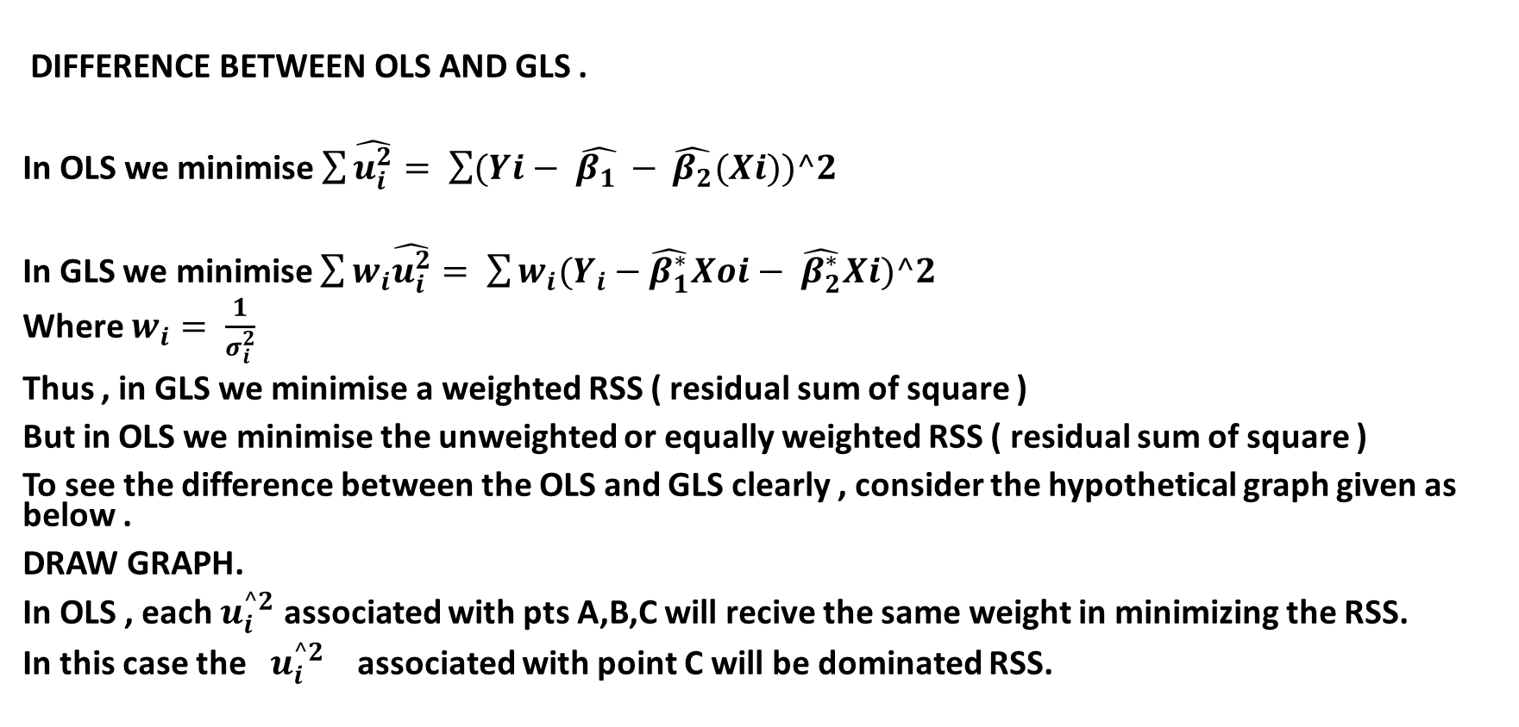
DIFFERENCE BETWEEN OLS AND GLS .
In OLS we minimise $\sum{\hat{u_{i}^{2}}}= \sum{(Yi− \hat{β_{1 }}− }\hat{β_{2}}(Xi))^2$
In GLS we minimise $\sum{w_{i}\hat{u_{i}^{2}}}= \sum{w_{i}(Y_{i}}−\hat{β_{1}^{∗}}Xoi− \hat{β_{2}^{∗}}Xi)^2$
Where $w_{i}= \frac{1}{σ_{i}^{2}}$
Thus , in GLS we minimise a weighted RSS ( residual sum of square )
But in OLS we minimise the unweighted or equally weighted RSS ( residual sum of square )
To see the difference between the OLS and GLS clearly , consider the hypothetical graph given as below .
DRAW GRAPH.
In OLS , each $u_{i}^{^2}$ associated with pts A,B,C will recive the same weight in minimizing the RSS.
In this case the $u_{i}^{^2}$ associated with point C will be dominated RSS.

Slide 13
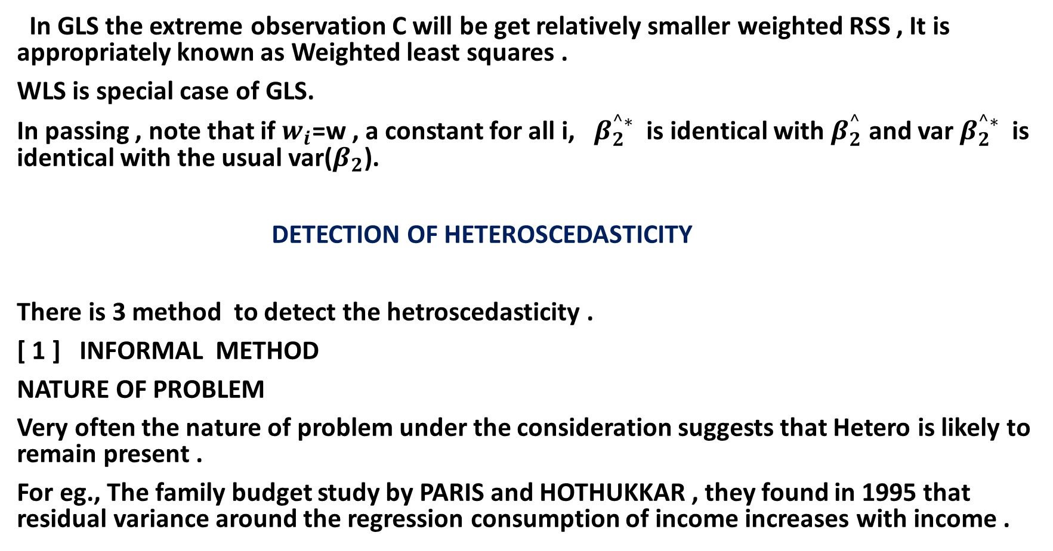
In GLS the extreme observation C will be get relatively smaller weighted RSS , It is appropriately known as Weighted least squares .
WLS is special case of GLS.
In passing , note that if $w_{i}$=w , a constant for all i, $β_{2}^{^∗}$is identical with $β_{2}^{^}$ and var $β_{2}^{^∗}$is identical with the usual var($β_{2}$).
DETECTION OF HETEROSCEDASTICITY
There is 3 method to detect the hetroscedasticity .
[ 1 ] INFORMAL METHOD
NATURE OF PROBLEM
Very often the nature of problem under the consideration suggests that Hetero is likely to remain present .
For eg., The family budget study by PARIS and HOTHUKKAR , they found in 1995 that residual variance around the regression consumption of income increases with income .

Slide 14
GRAPHICAL METHOD
Figure (a) indicates that the Heteroscedasticity is absent in the data where as figures from (b) to ( e ) indicate the presences of Heteroscedasticity .
A pattern such as that show in above figure , it suggest that the variance of the disturbance term is linearly related to the X variable .
It suggest that the variance is proportional to the value of income variable .
FORMAL TEST
There is many test to detect or to reduce the heteroscedasticity
Here , we use two test that is
[1] PARK TEST [2] GLEJSER TEST

Slide 15
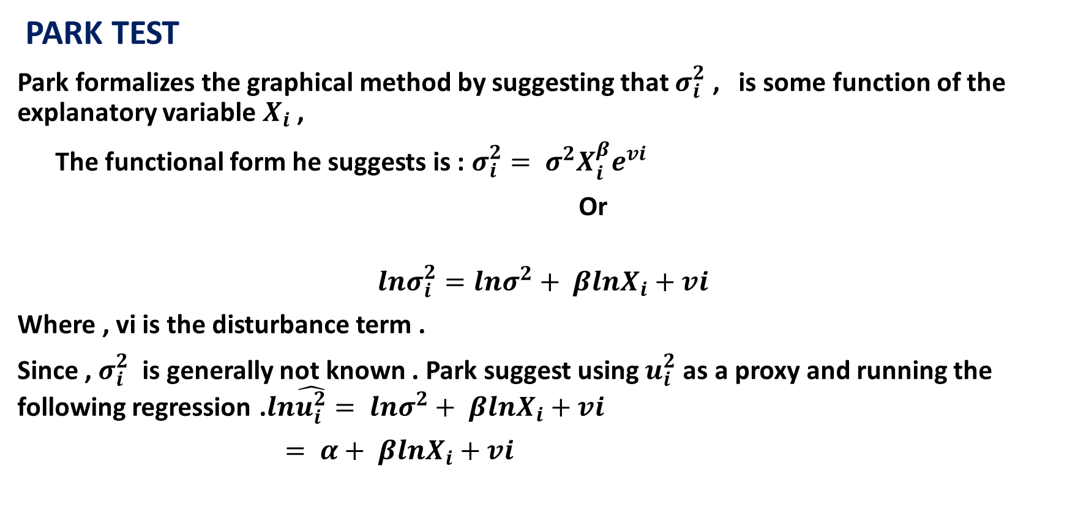
PARK TEST
Park formalizes the graphical method by suggesting that $σ_{i}^{2}$ , is some function of the explanatory variable $X_{i}$ ,
The functional form he suggests is : $σ_{i}^{2}= σ^{2}X_{i}^{β}e^{vi}$
Or
$$lnσ_{i}^{2}=lnσ^{2}+ βlnX_{i}+vi$$
Where , vi is the disturbance term .
Since , $σ_{i}^{2}$ is generally not known . Park suggest using $u_{i}^{2}$ as a proxy and running the following regression .$ln\hat{u_{i}^{2}}= lnσ^{2}+ βlnX_{i}+vi$
$= α+ βlnX_{i}+vi$

Slide 16
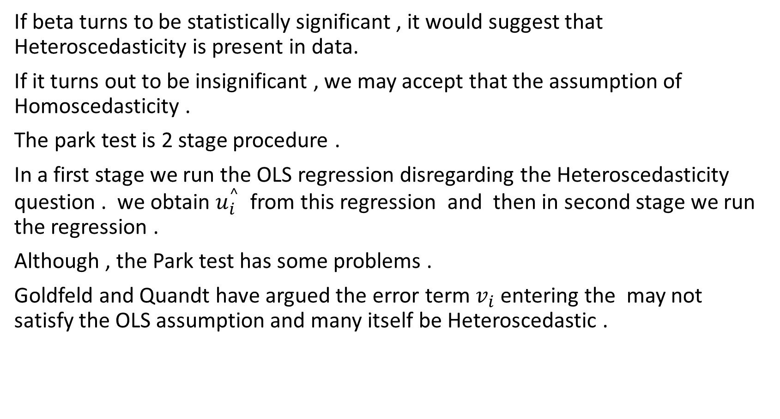
If beta turns to be statistically significant , it would suggest that Heteroscedasticity is present in data.
If it turns out to be insignificant , we may accept that the assumption of Homoscedasticity .
The park test is 2 stage procedure .
In a first stage we run the OLS regression disregarding the Heteroscedasticity question . we obtain $u_{i}^{^}$ from this regression and then in second stage we run the regression .
Although , the Park test has some problems .
Goldfeld and Quandt have argued the error term $v_{i}$ entering the may not satisfy the OLS assumption and many itself be Heteroscedastic .

Slide 17
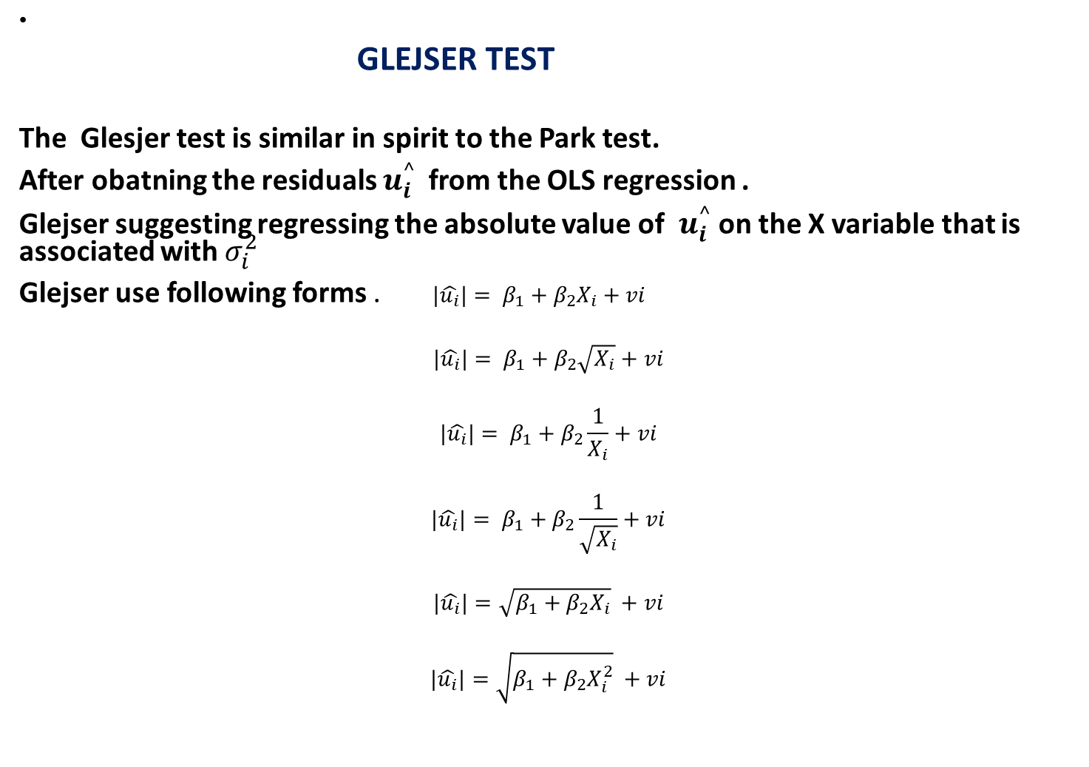
GLEJSER TEST
The Glesjer test is similar in spirit to the Park test.
After obatning the residuals $u_{i}^{^ }$ from the OLS regression .
Glejser suggesting regressing the absolute value of $u_{i}^{^}$ on the X variable that is associated with $σ_{i}^{2}$
Glejser use following forms . $|\hat{u_{i}}|= β_{1}+β_{2}X_{i}+vi$
$$|\hat{u_{i}}|= β_{1}+β_{2}\sqrt{X_{i}}+vi$$
$$|\hat{u_{i}}|= β_{1}+β_{2}\frac{1}{X_{i}}+vi$$
$$|\hat{u_{i}}|= β_{1}+β_{2}\frac{1}{\sqrt{X_{i}}}+vi$$
$$|\hat{u_{i}}|=\sqrt{β_{1}+β_{2}X_{i}} +vi$$
$$|\hat{u_{i}}|=\sqrt{β_{1}+β_{2}X_{i}^{2}} +vi$$

Slide 18
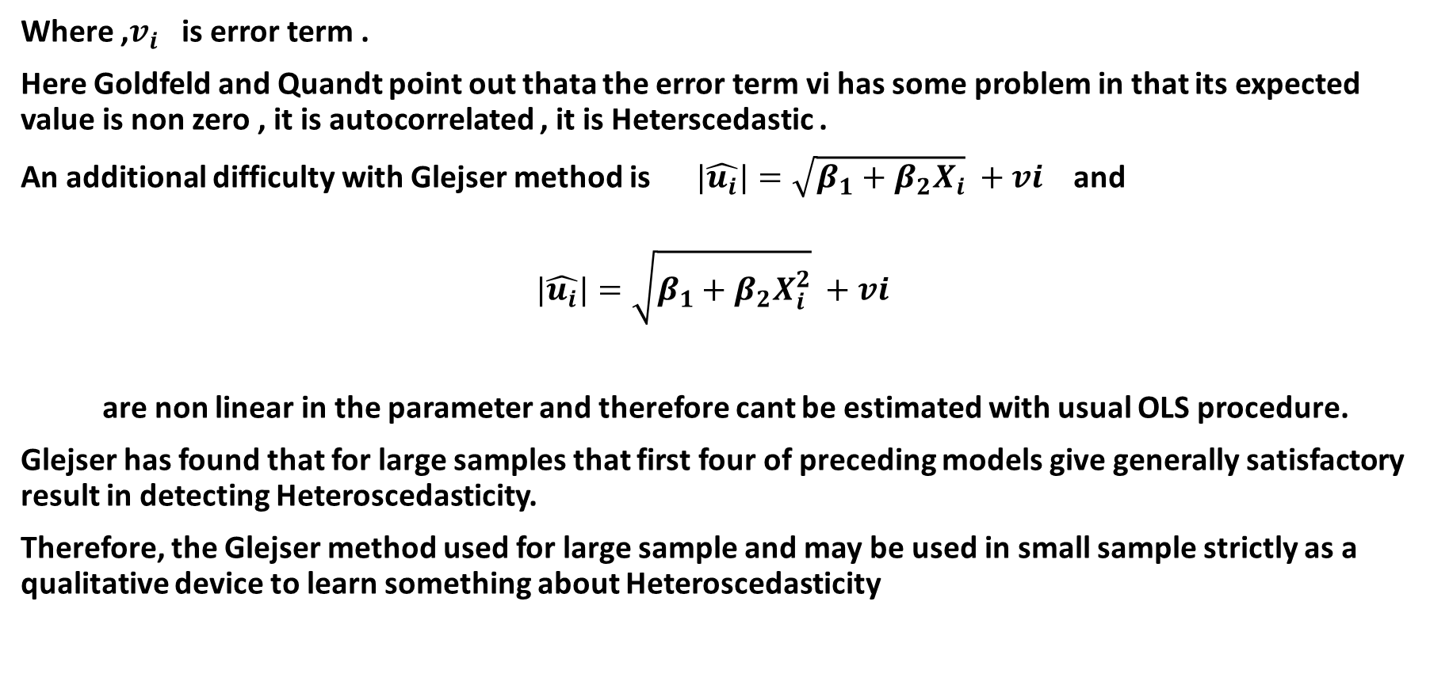
Where ,$v_{i}$ is error term .
Here Goldfeld and Quandt point out thata the error term vi has some problem in that its expected value is non zero , it is autocorrelated , it is Heterscedastic .
An additional difficulty with Glejser method is $|\hat{u_{i}}|=\sqrt{β_{1}+β_{2}X_{i}} +vi$ and
$$|\hat{u_{i}}|=\sqrt{β_{1}+β_{2}X_{i}^{2}} +vi$$
are non linear in the parameter and therefore cant be estimated with usual OLS procedure.
Glejser has found that for large samples that first four of preceding models give generally satisfactory result in detecting Heteroscedasticity.
Therefore, the Glejser method used for large sample and may be used in small sample strictly as a qualitative device to learn something about Heteroscedasticity

Slide 19
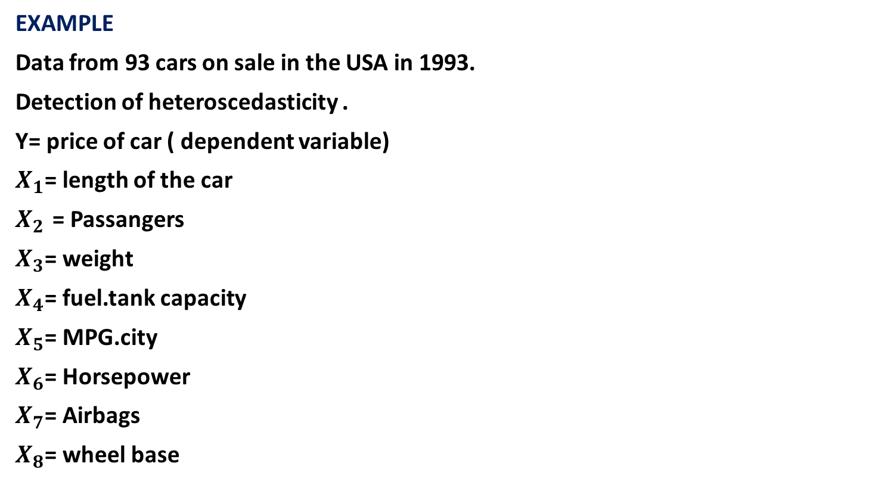
EXAMPLE
Data from 93 cars on sale in the USA in 1993.
Detection of heteroscedasticity .
Y= price of car ( dependent variable)
$X_{1}$= length of the car
$X_{2 }$= Passangers
$X_{3}$= weight
$X_{4}$= fuel.tank capacity
$X_{5}$= MPG.city
$X_{6}$= Horsepower
$X_{7}$= Airbags
$X_{8}$= wheel base

